Slide 1
Preliminary evaluation of bespoke spatiotemporal embeddings for sub-pixel landscape feature detection
Luka Antonić, Josip Križan, Barbara Štimac Tumara, Andreja Radović, Ivan Pilaš

Slide 2
...or embeddings with a shallow foundation

Slide 3

Who am I?
Senior GIS developer at MultiOne Ltd
PhD student at Faculty of Geodesy, University of Zagreb

Slide 4



What is this about?
Landscape feature (CAP) detection in 10m pixels on national level.
Funded under ESA PECS call 2024, completed early 2026
Collaboration with GEOF, IRB
PoC for monitoring method as alternative to costly on-site surveys
Leverage national land parcel identification system (ARKOD) as target data, use open data from Copernicus as covariates
Sentinel-2 true color composite (Copernicus)

Slide 5
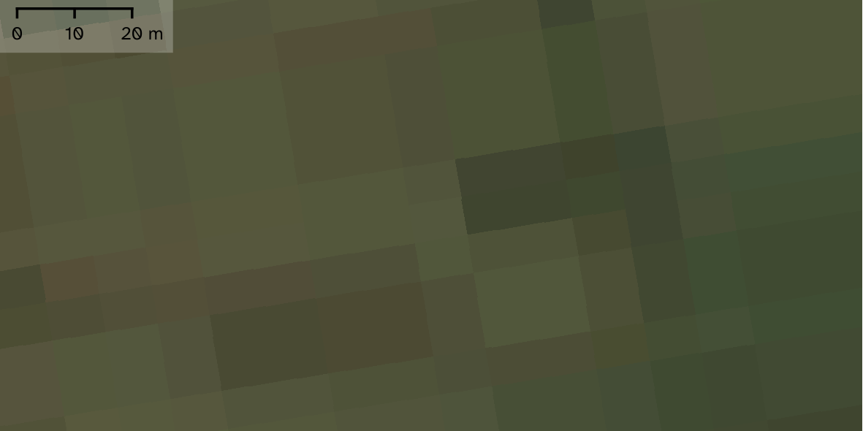
Sentinel-2 true color composite (Copernicus)

Slide 6
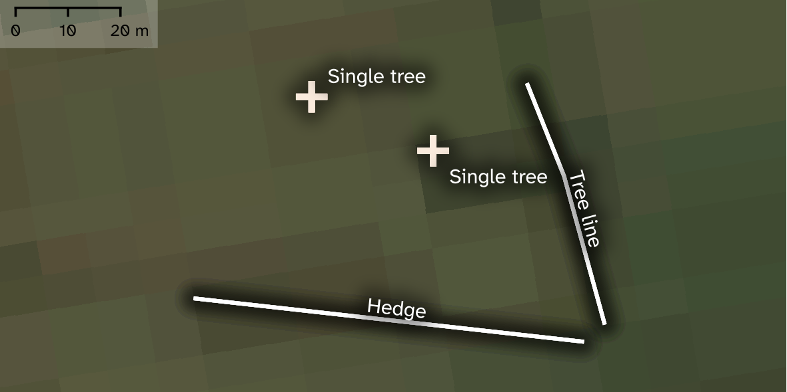
Landscape feature data from ARKOD inventory (APPRRR); Sentinel-2 true color composite (Copernicus)

Slide 7
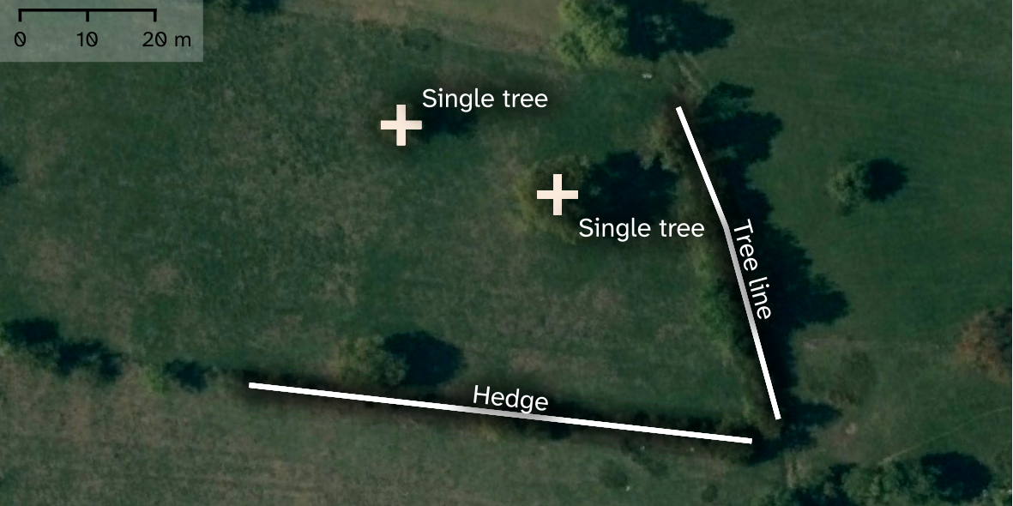
Landscape feature data from ARKOD inventory (APPRRR); 0.25m resolution orthophoto imagery (DGU)

Slide 8
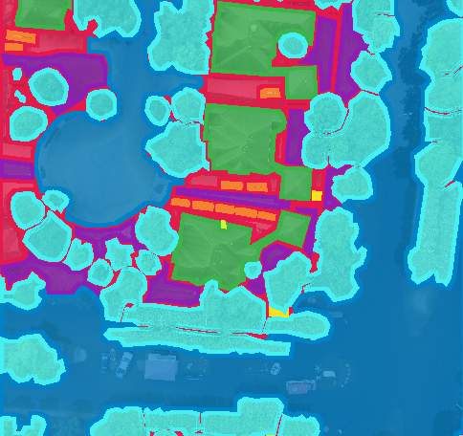
Missing context
Common methods for introducing context, like semantic segmentation, not applicable here
Beneficial to introduce spatial context anyway (e.g. features intersecting multiple pixels)
Temporal context helps as well (e.g. differentiating between phenological patterns)
Alchimowicz, J, 2022: Semantic Segmentation Satellite Imagery - datasetninja.com

Slide 9
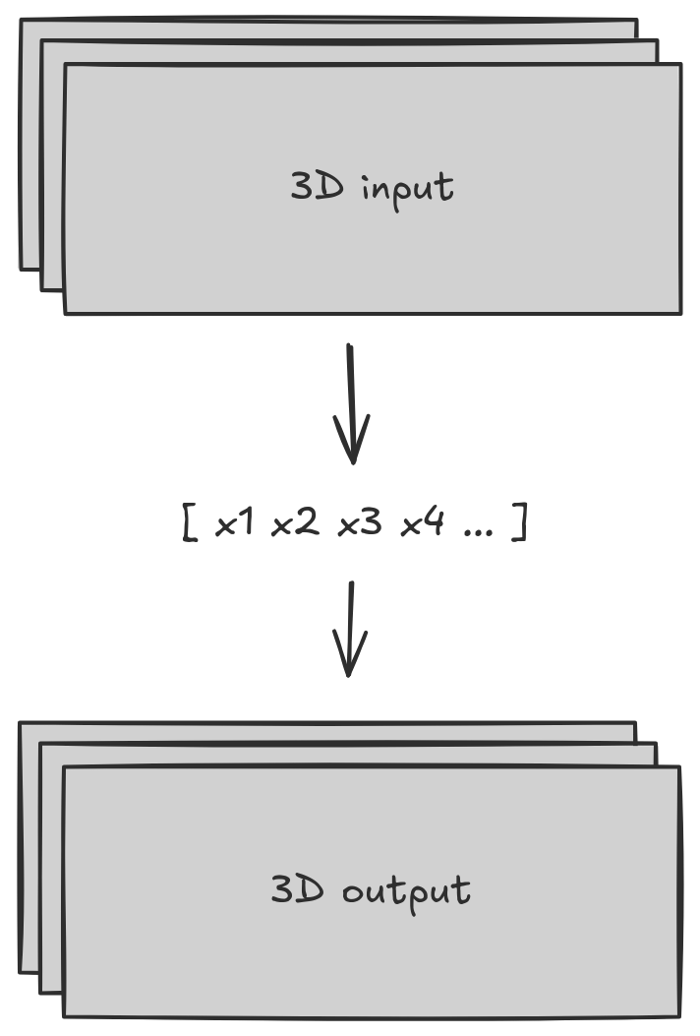
Geospatial (+ temporal) embeddings
A priori context extraction due to (potentially) disproportionate availability of context samples vs ML target data
Self-supervised methods – compression of extracted patterns into vector representations and reconstruction at the output
Several global embedding datasets (AlphaEarth, Tessera...) readily available and already being used for various tasks
...but we produced our own instead

Slide 10
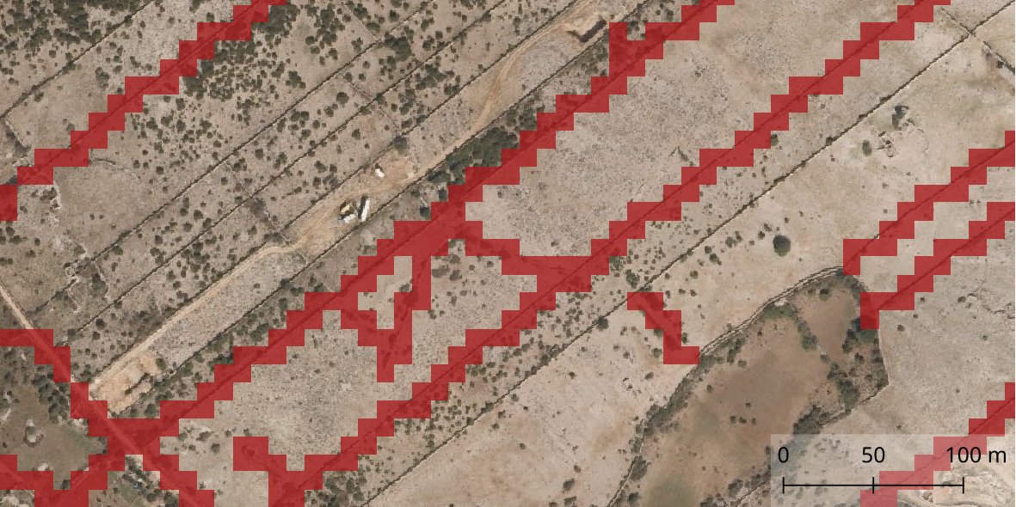
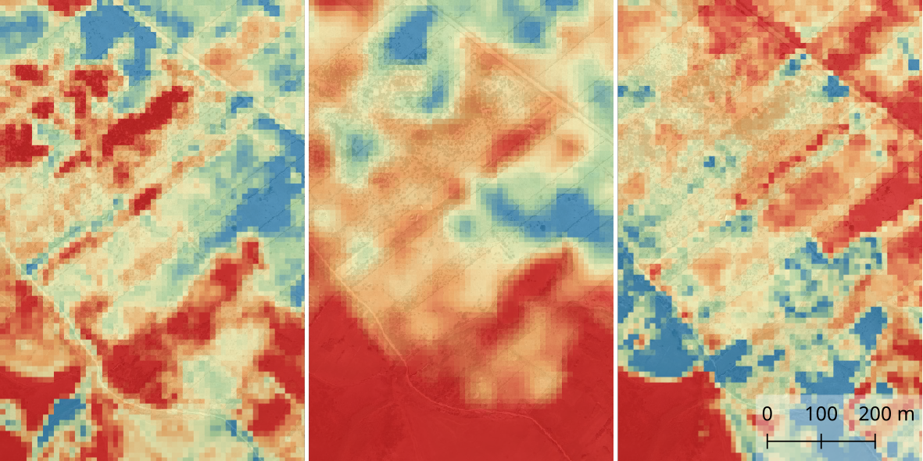
Methods
ARKOD dataset (land parcels + landscape feature vectors) as target - seven feature classes (ditch, drywall, grove, hedge, pond, single tree and tree line) rasterised into binary label masks; absence modelled as –10m buffer inside ARKOD parcels
Sentinel-2 (RGB+NIR seasonal mosaics), Sentinel-1 GRD (VV, VH monthly mean), Plant Phenology Index (10-day Seasonal Trajectories) used as covariates
ARKOD data (APPRRR) binary feature mask for drywall; S2 NIR, S1 GRD VH, PPI ST (Copernicus)

Slide 11

Methods
Simple 3D convolutional autoencoder trained on 5x5 windows of covariate timeseries (one per each band) - only on known agricultural parcels (ARKOD)
Resulting 64-band embedding vectors added as covariates (704 total embedding bands, 804 total covariate features)

Slide 12
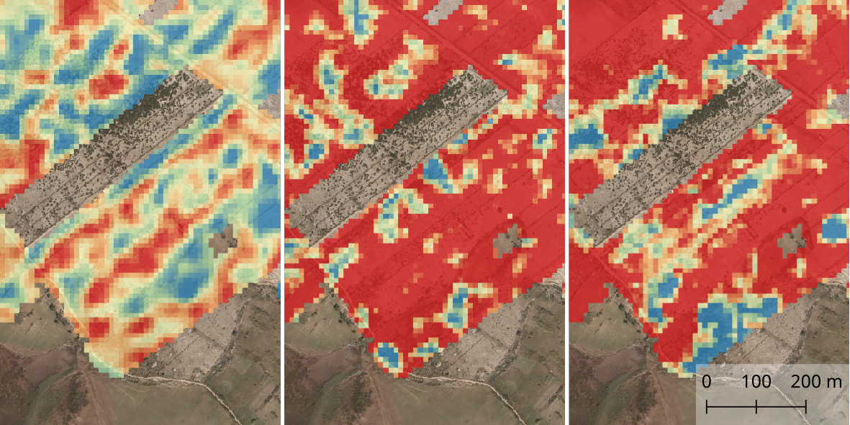
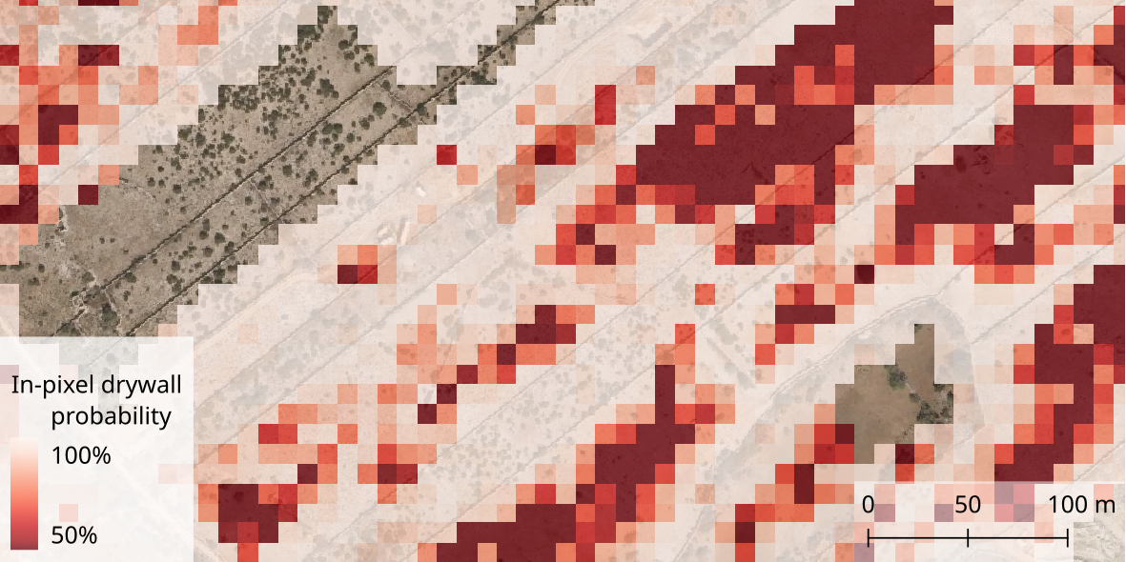
Methods
Multiclass XGBoost classifier tuned for optimal weighted F1
Inference mask expanded with CLC 2018 (arable land and permanently irrigated land)
Per-class, per-pixel probability rasters produced as output
S2 NIR, S1 GRD VH, PPI ST embeddings (FCC from first three bands); pixel-wise probability map for drywall

Slide 13
Results
Classification performance without embedding covariates
Class | Precision | Recall | F1-score
ditch | 0.76 | 0.79 | 0.77
drywall | 0.83 | 0.92 | 0.87
grove | 0.74 | 0.85 | 0.79
hedge | 0.71 | 0.79 | 0.75
pond | 0.95 | 0.38 | 0.54
single tree | 0.49 | 0.13 | 0.2
tree line | 0.75 | 0.53 | 0.62
Classifier performance increased uniformally through the use of embedding covariates
4 feature classes with F1-scores above 0.8 (without embeddings - only one)
Probability map revealed some caveats: disproportionately high probability of dominant class in some cases (when presence not observed in-pixel)
Classification performance with embedding covariates
Class | Precision | Recall | F1-score
ditch | 0.81 | 0.85 | 0.83
drywall | 0.85 | 0.93 | 0.89
grove | 0.84 | 0.92 | 0.88
hedge | 0.79 | 0.88 | 0.83
pond | 1.00 | 0.55 | 0.71
single tree | 0.65 | 0.18 | 0.28
tree line | 0.87 | 0.72 | 0.79

Slide 14
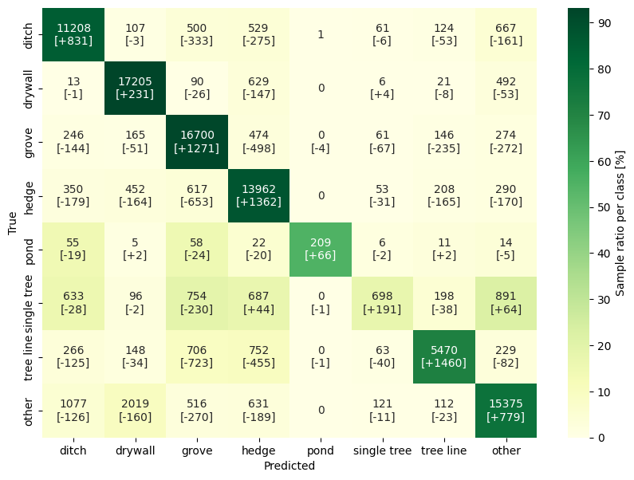

Slide 15
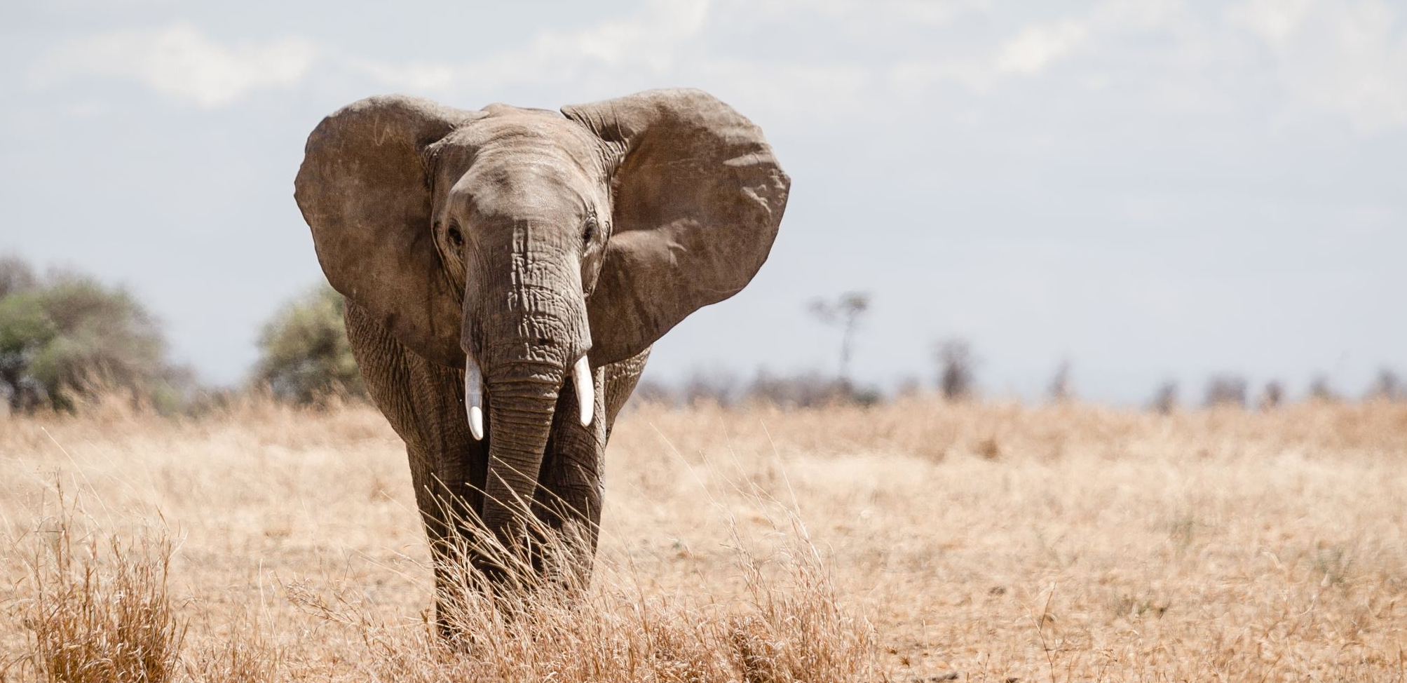
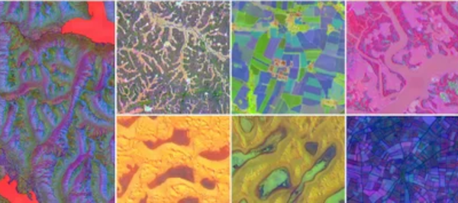
Post-mortem benchmark vs SOTA
AlphaEarth: 64-channel embeddings developed at Google DeepMind from diverse mix of EO data sources
Tessera: fully open foundational model fusing Sentinel-1 and Sentinel-2 data into 128-channel embeddings; developed at Cambridge
An elephant, having left the room; AlphaEarth embeddings (spectrum.ieee.org)

Slide 16
Benchmark method and results
Classification performance with project embeddings
Class | Precision | Recall | F1-score
ditch | 0.78 | 0.82 | 0.8
drywall | 0.83 | 0.93 | 0.88
grove | 0.82 | 0.91 | 0.86
hedge | 0.77 | 0.84 | 0.8
pond | 0.93 | 0.44 | 0.6
single tree | 0.57 | 0.12 | 0.2
tree line | 0.85 | 0.67 | 0.75
AlphaEarth and Tessera sampled at each point in the classification dataset
Identical classification method as before (XGBoost, tuned for optimal weighted F1) for each of the 3 embedding datasets
Only embeddings used as covariates
Classification performance with AlphaEarth embeddings
Classification performance with Tessera embeddings
Class | Precision | Recall | F1-score
ditch | 0.81 | 0.84 | 0.83
drywall | 0.88 | 0.95 | 0.91
grove | 0.84 | 0.92 | 0.88
hedge | 0.82 | 0.89 | 0.85
pond | 0.96 | 0.7 | 0.81
single tree | 0.54 | 0.15 | 0.24
tree line | 0.86 | 0.75 | 0.8
Class | Precision | Recall | F1-score
ditch | 0.61 | 0.63 | 0.62
drywall | 0.82 | 0.91 | 0.86
grove | 0.63 | 0.78 | 0.69
hedge | 0.6 | 0.64 | 0.62
pond | 0.82 | 0.23 | 0.36
single tree | 0.43 | 0.11 | 0.18
tree line | 0.52 | 0.28 | 0.36

Slide 17
Conclusion
Path forward
Project results validate use of spatiotemporal embeddings for sub-pixel object detection
Benchmark results suggest both merit in producing localised embedding datasets, and much room for methodological improvement
Utilise strength of SOTA foundational models: investigate transfer learning/fine tuning, as well as implement atomic architectural improvements based on established findings

Slide 18

Q&A?
Interpretability problem with embeddings – any ideas?
Anyone interested in benchmarking this method on their own ML tasks?
Any comments, questions, grievances?
lantonic@multione.hr
mo.hr
Thank you!

